Slide 1

April Quarterly Membership Meeting
Tuesday, April 18th, 2023
7:00 PM

Slide 2
Agenda
Welcome/Know Your Neighbors Night
Juliette Smith, President
Introduction to the 2023 Board
Juliette Smith, President
District 14 City Council Candidates Q&A
Paul Ridley, Amanda Schulz, Joseph Miller (Moderate By Kathryn Luscri, Governance)
Real Estate Report
Anne Tudhope, TX Lake & Land
ENP Update
Anne Tudhope, ENP Chair
Treasurer Report
Janet Stegner, Treasurer
Social Update
Eileen Thomas, Social Chair
HSMNA Board Q&A
HSMNA Board of Directors
Closing Remarks
Juliette Smith, President

Slide 3

Know Your Neighbors Night
Know Your Neighbors Night is this Thursday beginning at 5:30pm!
Join us on the 400 block of Cordova!
Neighbors have generously offered to host this quarter. They have both indoor and outdoor cats and ask that all canine friends sit this one out. Thank you!

Slide 4
Meet Your 2023 HSMNA Board!
Juliette Smith (President)
Janet Stegner (Vice President/Treasurer)
Jamie Johnson (Secretary/Membership – Tactical)
Anne Tudhope (ENP)
Eileen Thomas (Social)
Buffie Bogue (Social Media)
Katie Hill (Website)
Jennifer Near (Historian)
Ed Zahra (Newsletter/Code & Zoning, Conservation District)
Rob Parks (Landscape)
Joe Kacynski (Sponsorship)
Kathryn Luscri (Governance)

Slide 5
District 14 City Council Candidates Q&A
Paul Ridley, Amanda Schulz, Joseph Miller
Moderate By Kathryn Luscri, Governance

Slide 6
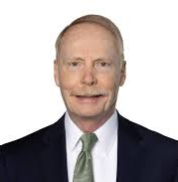
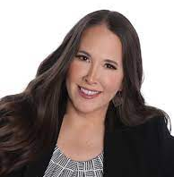
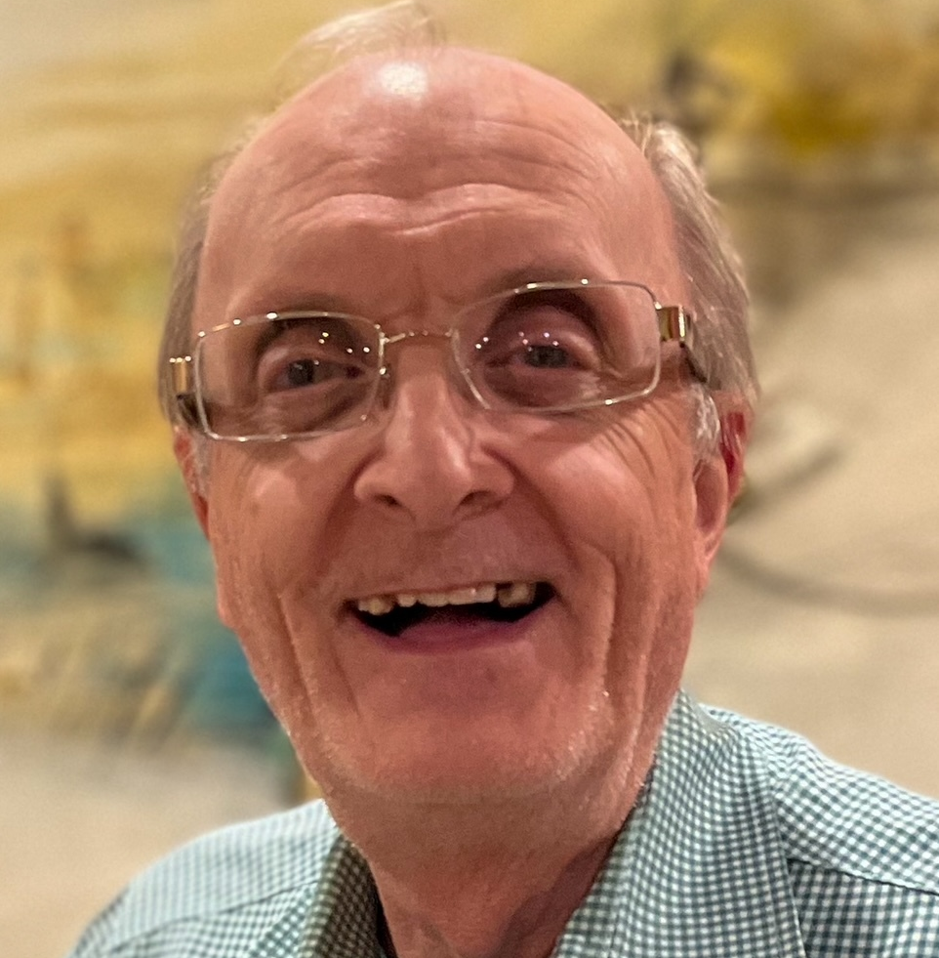
Candidate Introductions
Paul Ridley
Amanda Schulz
Joseph Miller
One minute introduction from each candidate.
Two minutes each to answer question.

Slide 7
ACCESSIBILITY/TRAFFIC CALMING
HSM’s Accessibility and Traffic Calming Study indicated grassroots support for more curb cuts, pedestrian crossings and safer more efficient pedestrian circulation within our neighborhood and to attractors such as Lakewood Shopping Center.
What specific bond and budget measures would you facilitate insure a safer, quieter, more pedestrian-connected HSM?

Slide 8
Conservation District
The Hollywood/Santa Monica Conservation District is a core neighborhood value passed by over 97% of its residents, yet City staff struggles to provide fast permit approval and enforcement of violations.
How would you ensure the City manager’s budget contains adequate training and staffing for timely review of Conservation District renovation plans and Conservation District violations?

Slide 9
Short-Term Rental Regulations
As represented in the media, too many Dallas residential neighborhoods have found themselves invaded by illegal Short-term Rentals ( STRs) .
Do you support the KISS proposal defining STRs as a Lodging Use in the Dallas Development Code so it is clear where STR Mini-hotels can operate?

Slide 10
Gunfire
Hearing gunfire in our local neighborhoods has become a frequent occurrence, no longer heard just around the holidays. Neighbors have found bullets in/on their property and on the Santa Fe Trail. The police patrol the area(s), but unless there is an actual address or they can hear the gunfire there is not a lot they can do. With the decreased number of police, the response time affects this as well.
What is the strategy or long-term philosophy to deter this unacceptable behavior. How do you believe you can impact this problem?

Slide 11
Real Estate Report
Anne Tudhope, TX Lake & Land

Slide 12
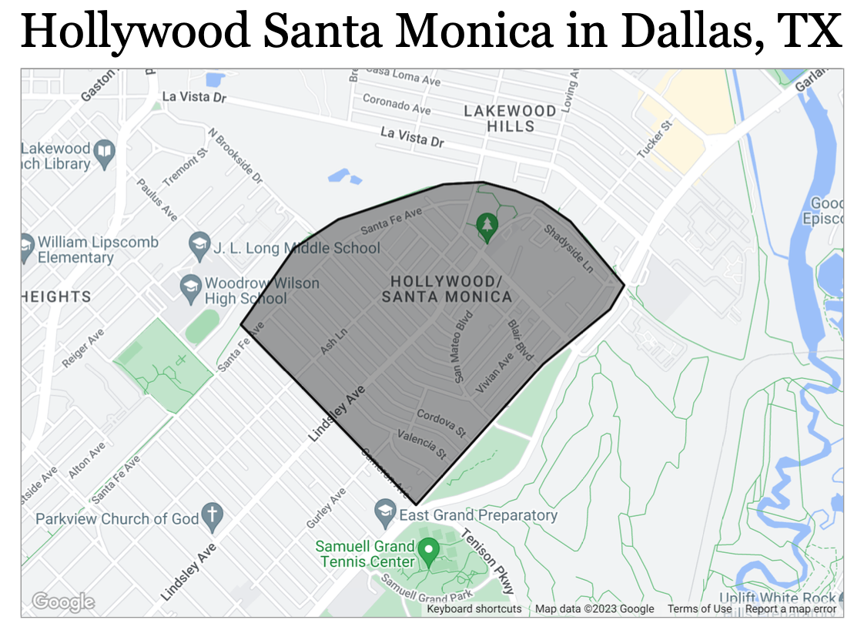
Real Estate Market Report – 1st Quarter 2023

Slide 13
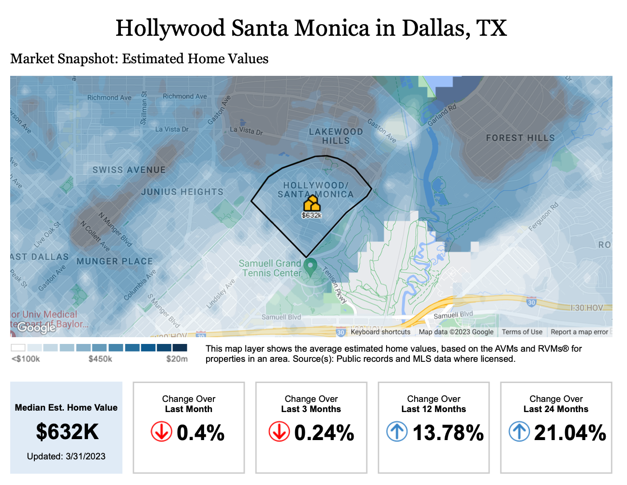

Slide 14
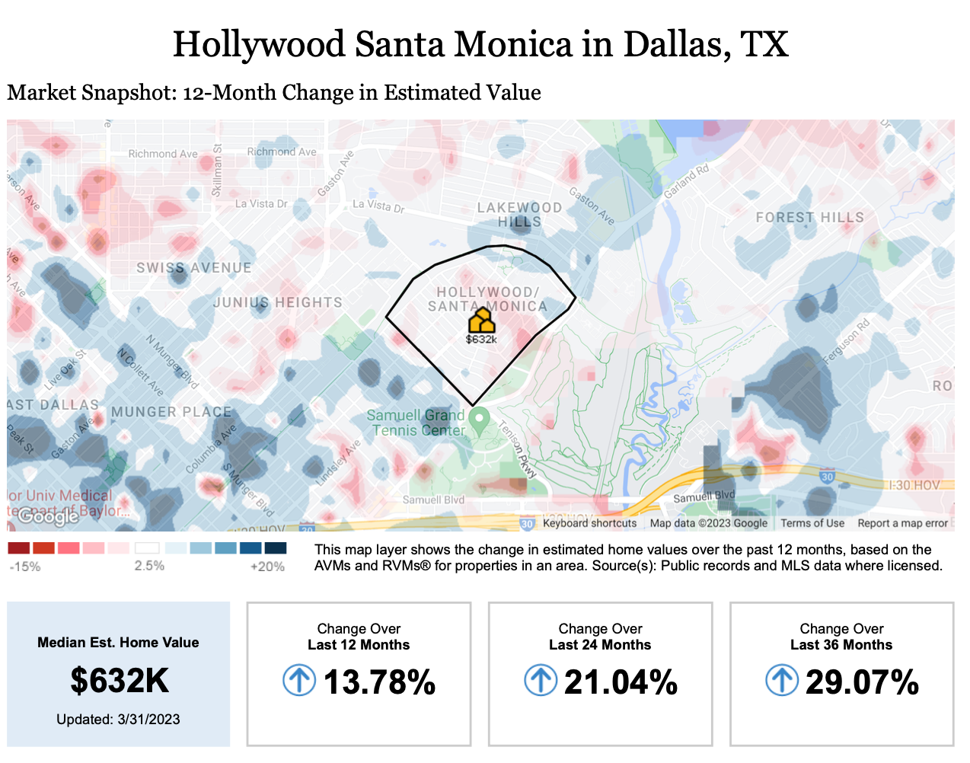

Slide 15
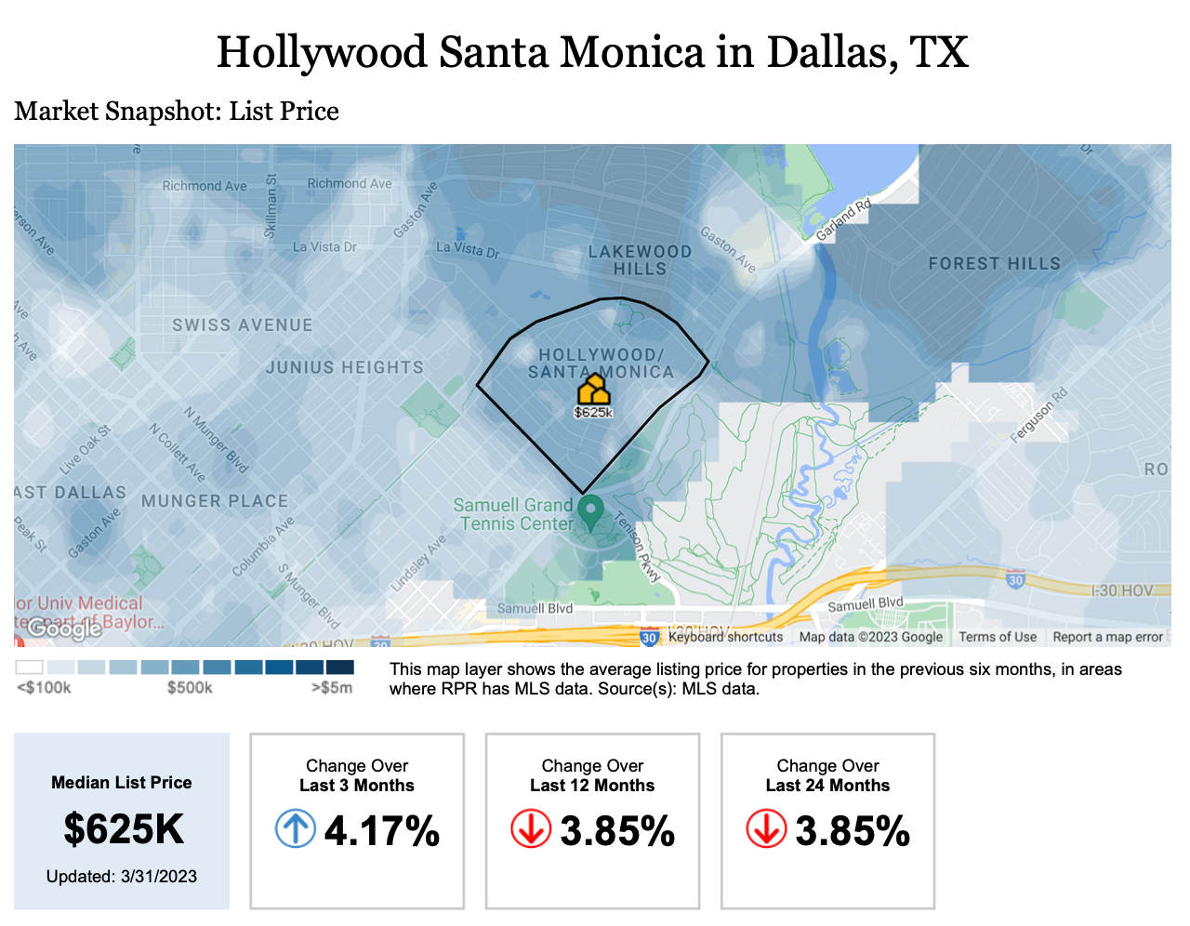

Slide 16
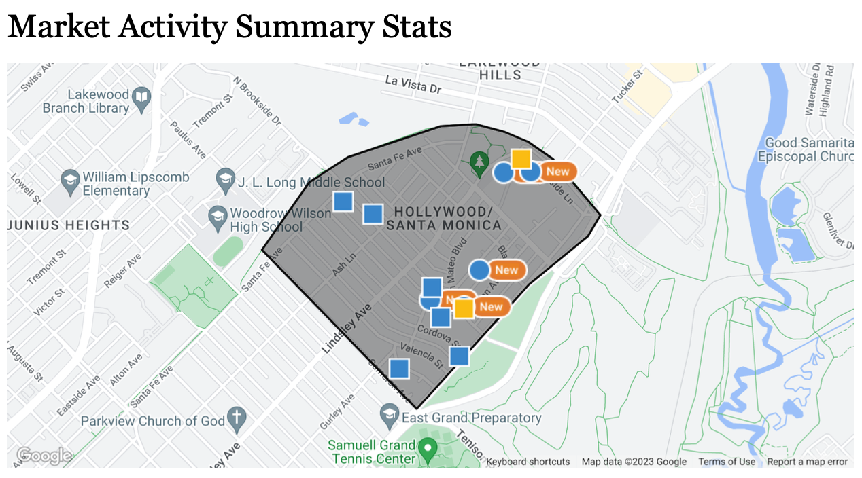
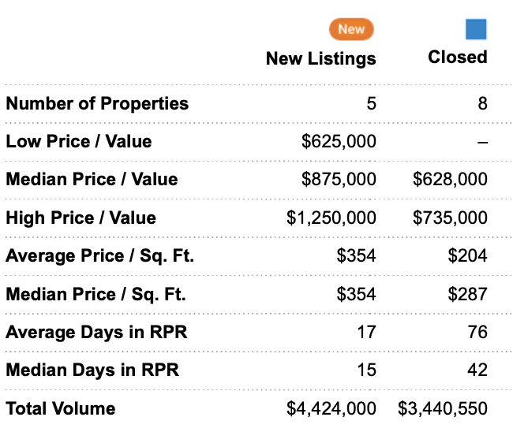

Slide 17
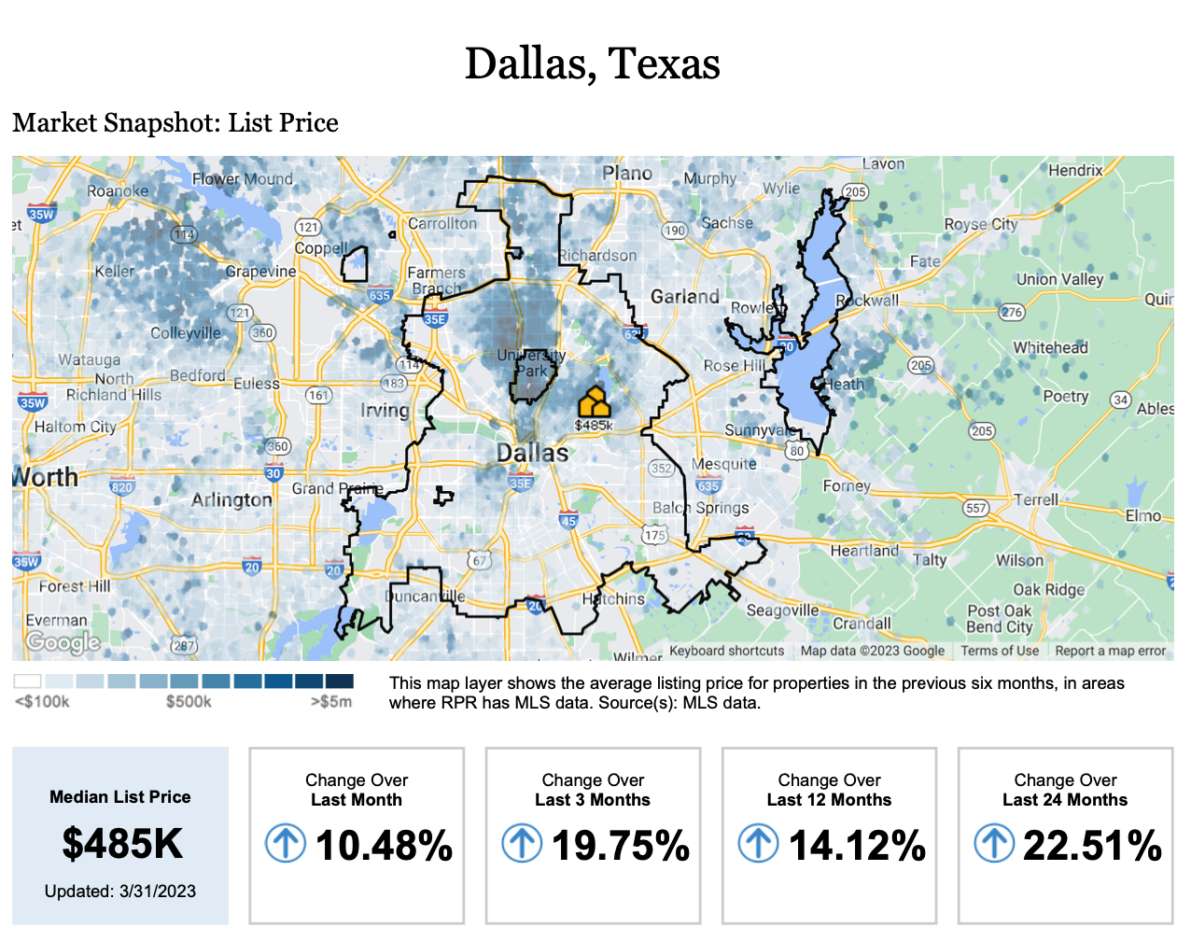

Slide 18
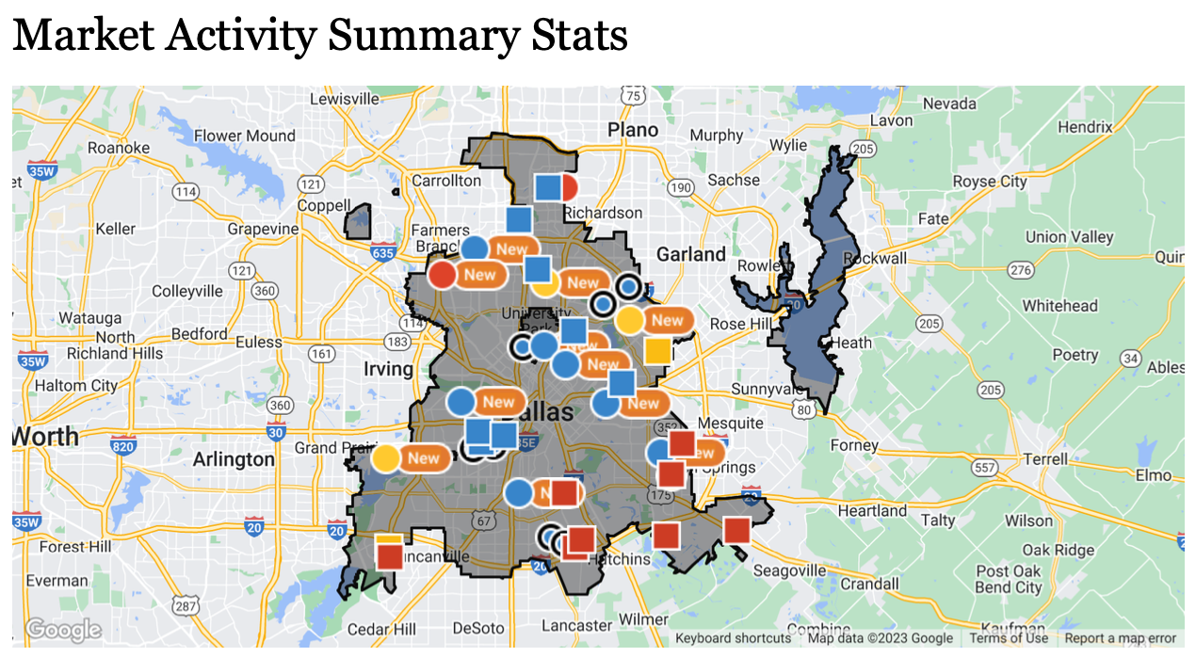
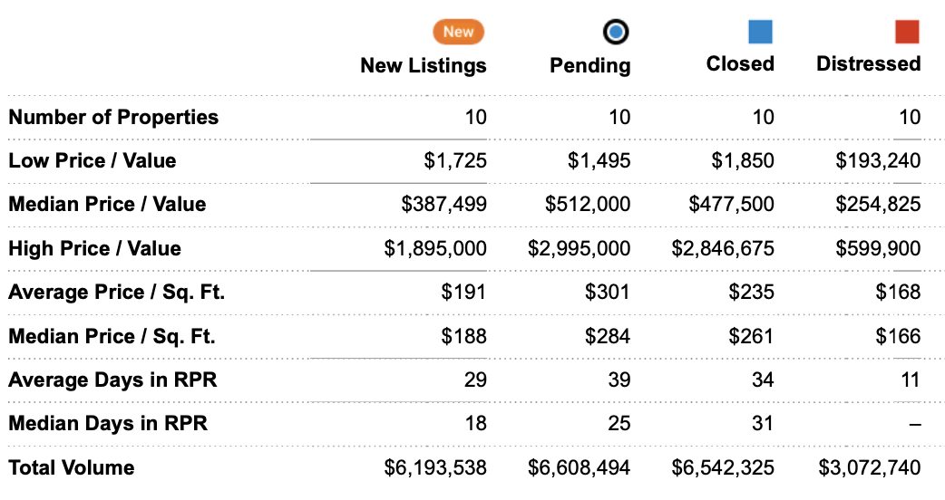

Slide 19
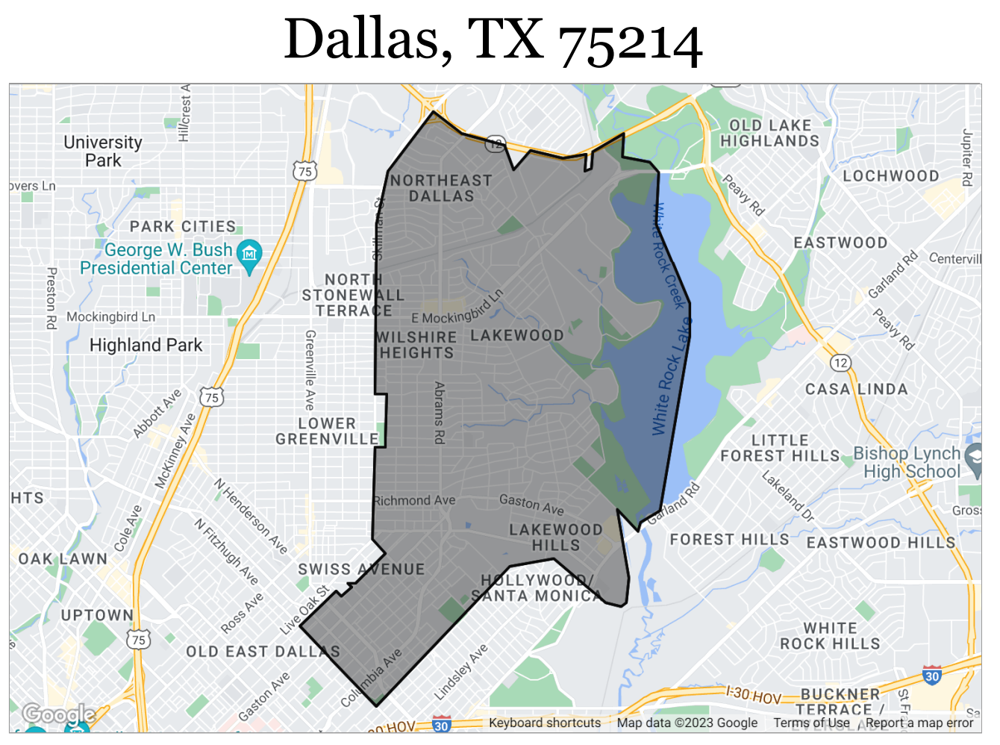

Slide 20
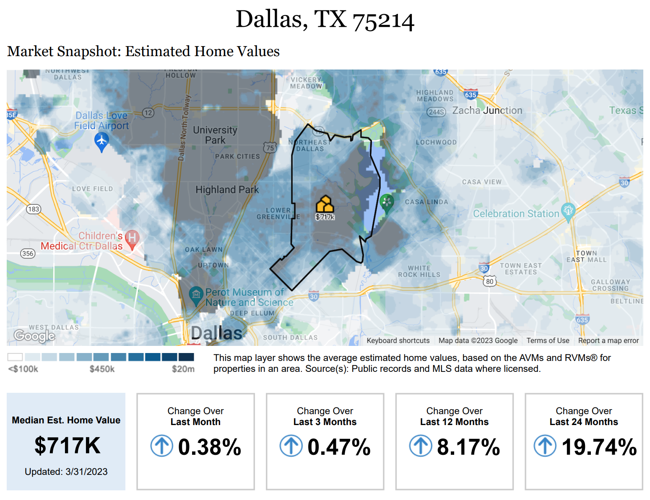

Slide 21
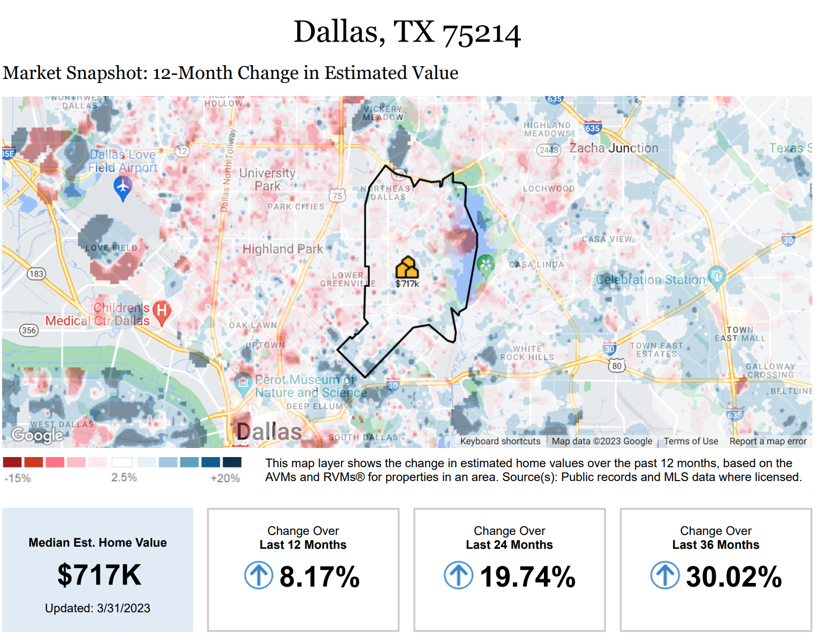

Slide 22
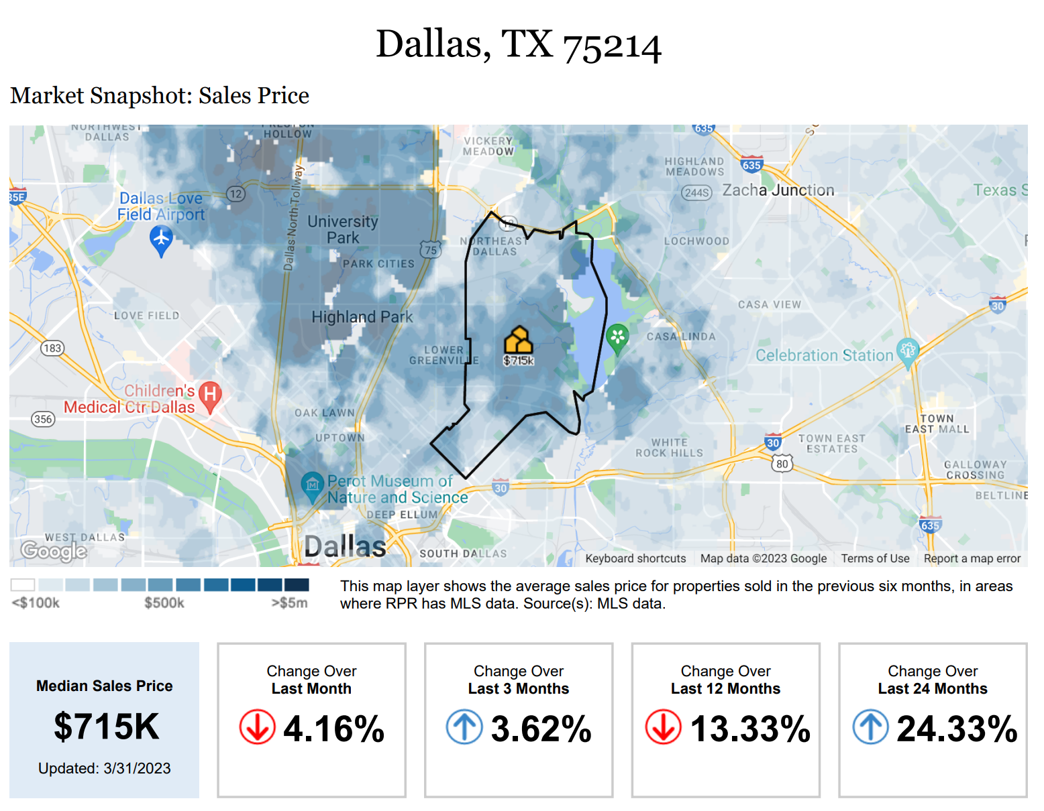

Slide 23
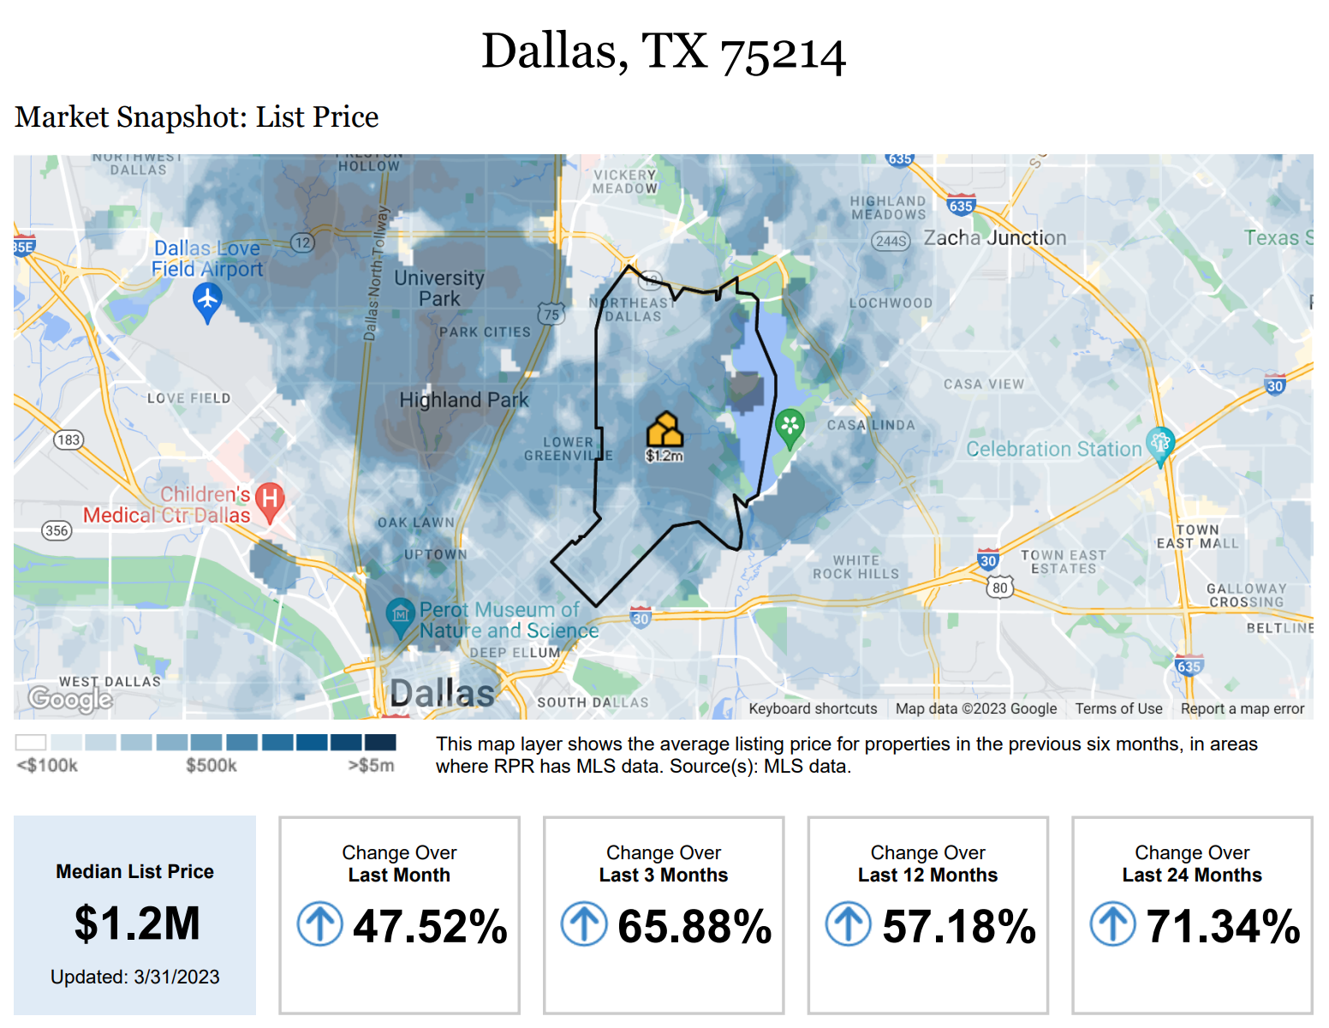

Slide 24
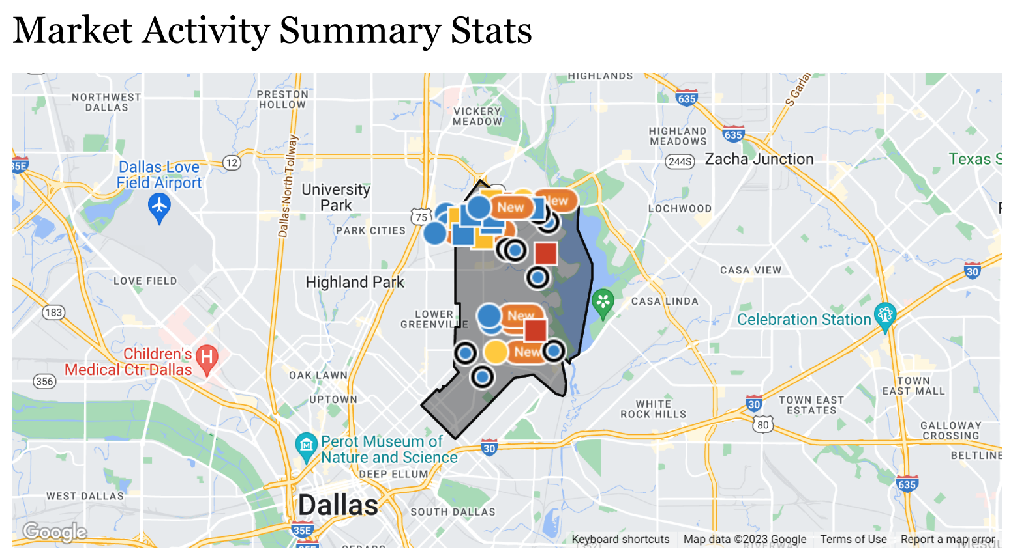
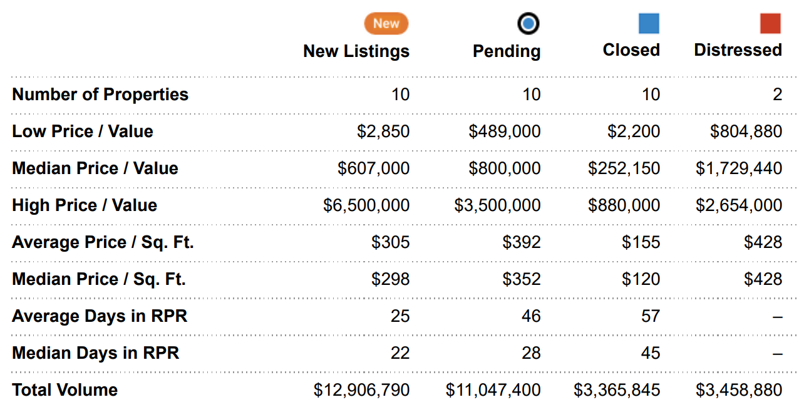

Slide 25
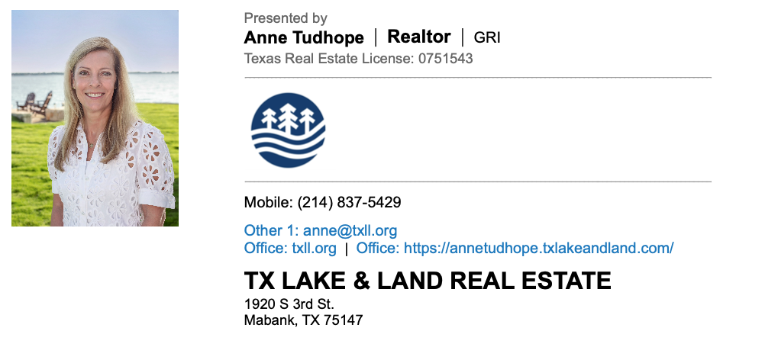

Slide 26
Extended Neighborhood Patrol
Anne Tudhope, ENP Chair

Slide 27
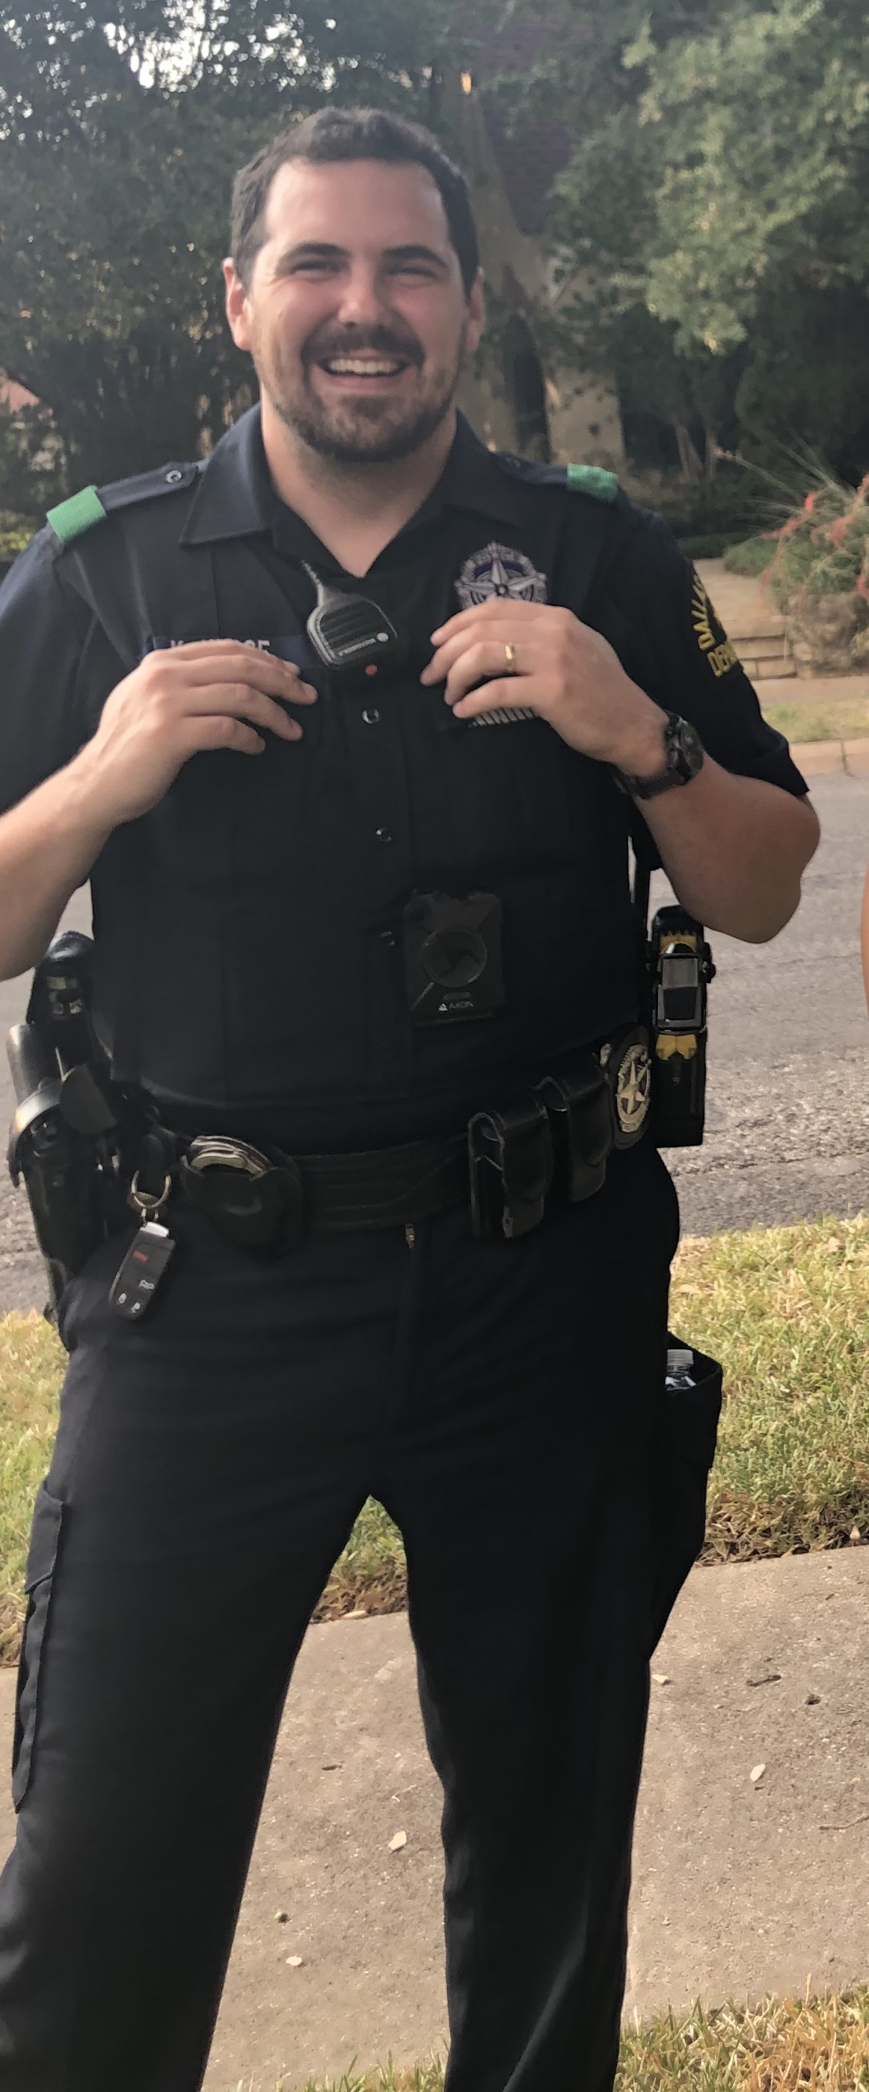
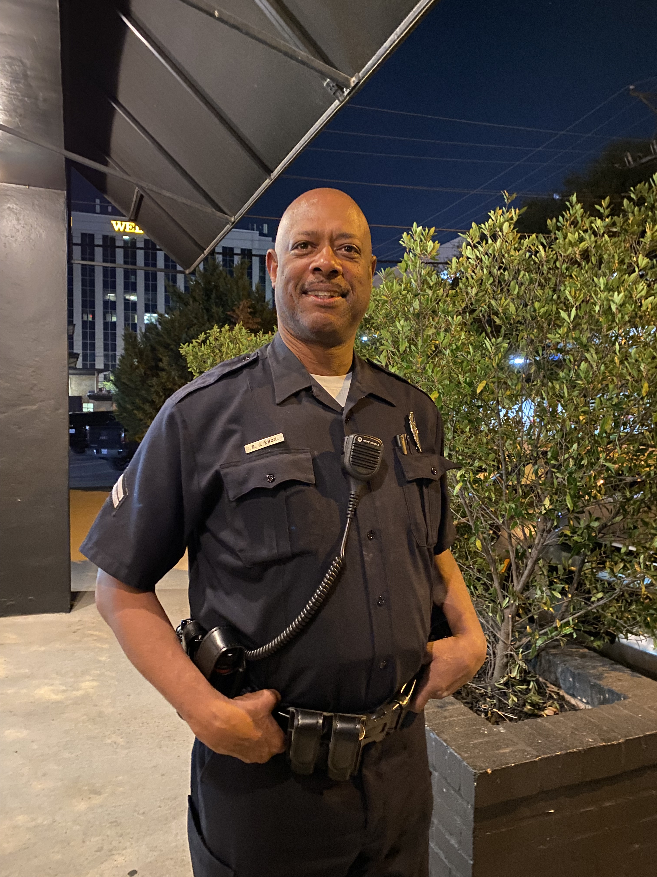
ENP Officer Team
Officer Kirk Hesse – ENP Coordinator and member of out team for the past 3 years
Officer Reginal Knox – new to our team. Has been working in our neighborhood since the Home Tour.
Officer Hesse
Officer Knox

Slide 28
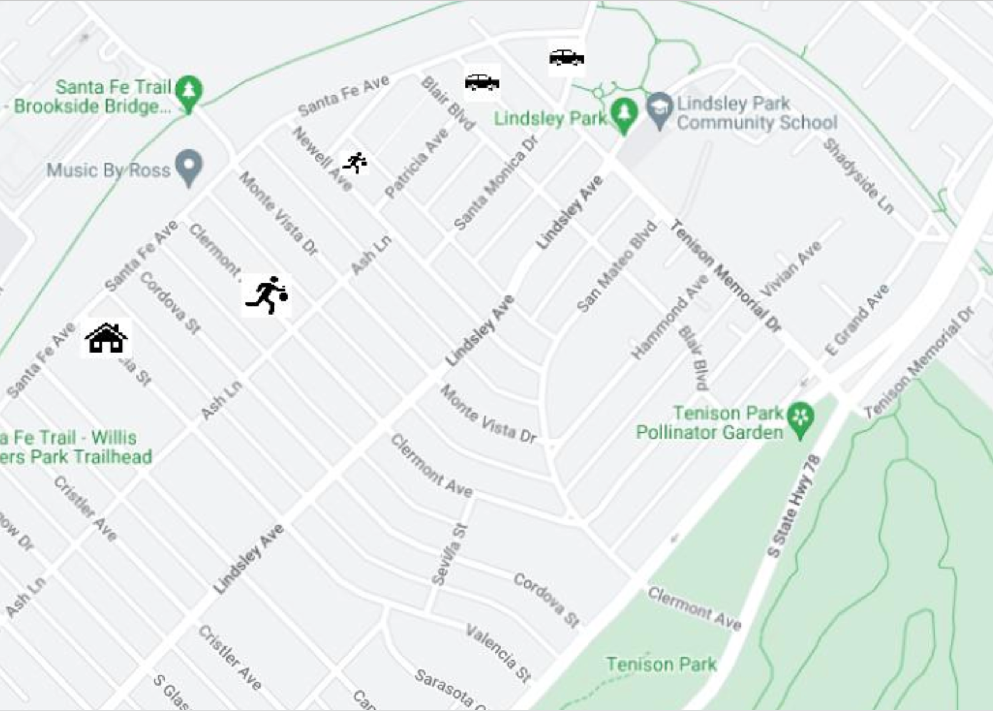
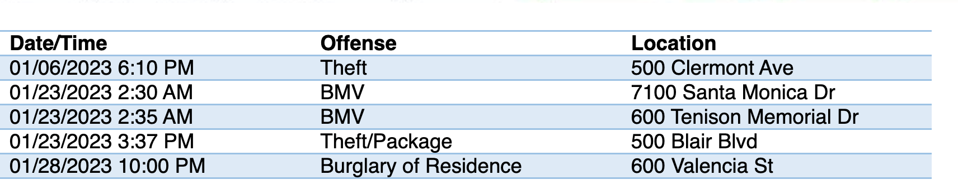
HOLLYWOOD/SANTA MONICA OFFENSES January - February, 2023

Slide 29
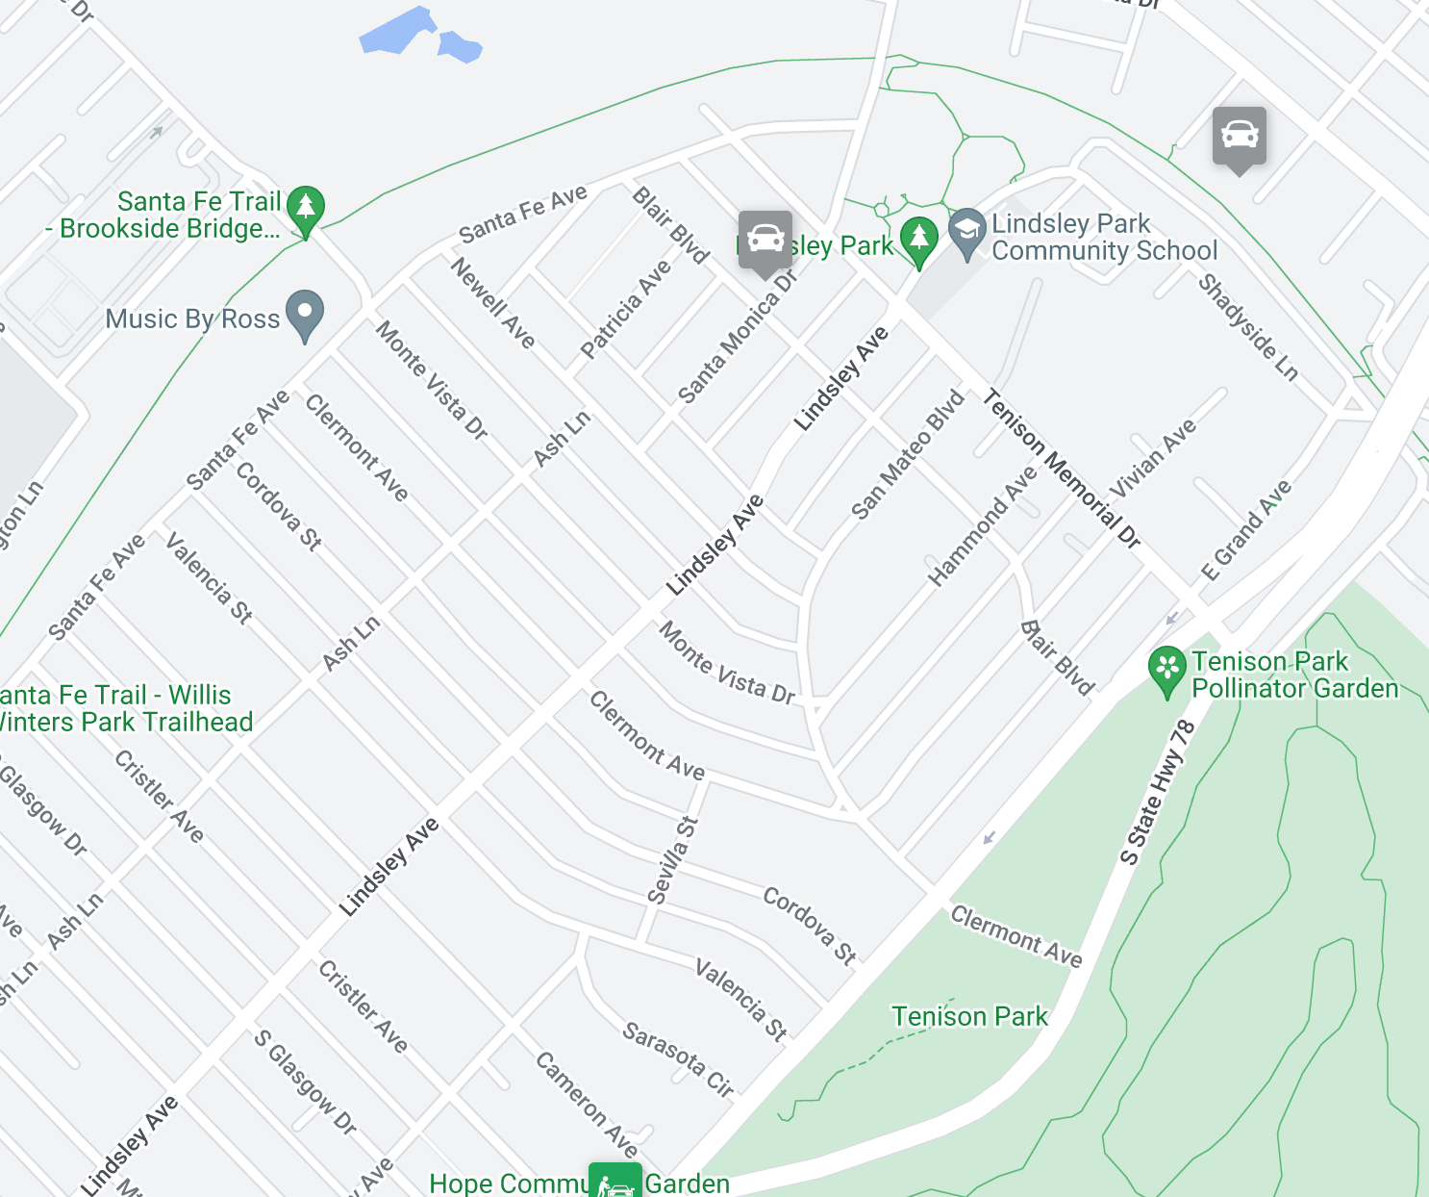
HOLLYWOOD/SANTA MONICA OFFENSES March 1-31, 2022

Slide 30
ENP Membership 2023
ENP Membership in 2022 = 208 homes
ENP Membership to date in 2023 = 190 homes
  Clermont = 31 members
  Cordova = 29 members
  Valencia = 24

Slide 31
Treasurer Report
Janet Stegner, Treasurer

Slide 32
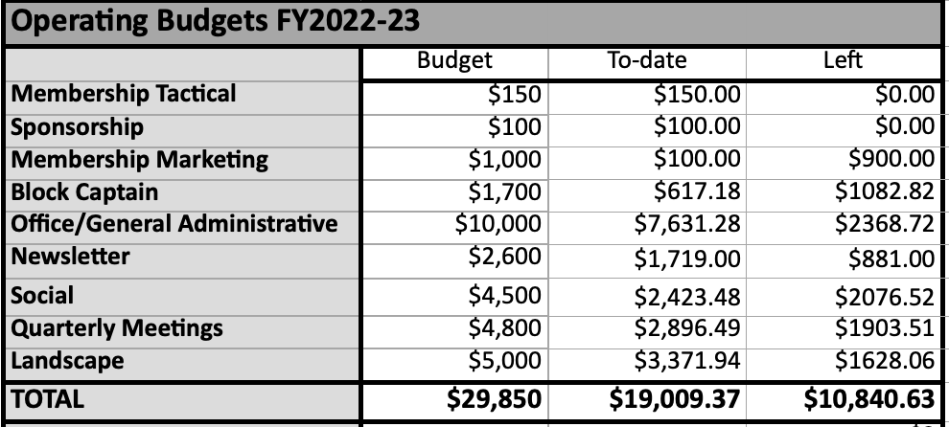
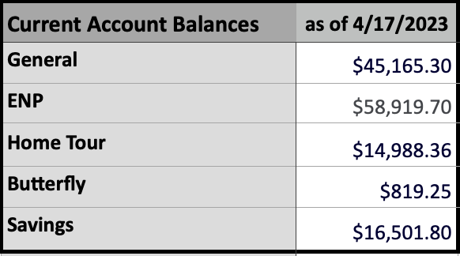
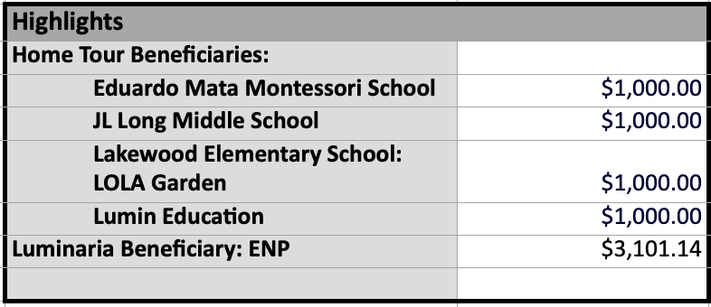

Slide 33
Social Report
Eileen Thomas, Social Chair

Slide 34


Slide 35
HSMNA Board Q&A
Ask us anything!

Slide 36
Thank you for your support!
See you on Thursday for Know Your Neighbors Night!
Don’t forget to renew your membership or join at HSMNA.org!

